Slide 1
Update: Develop a Framework for a Countywide Regional Water Committee
Presentation to LAFCO Board of Directors
January 9,2024
Multiagency Collaboration Team:
Eric Rosenblum
Bob Raucher
Dave Smith
Shannon Spurlock
Felicia Marcus

Slide 2
Overview
LAFCO Municipal Services Review Recommendation
Project Objective and Approach
Preliminary Findings:
What we heard
What we could achieve
Next Steps

Slide 3
Recommendation #1:
Alameda LAFCO should create a Countywide Regional Water and Wastewater Committee that includes all affected agencies…to share practices for collaboration on how the region can recycle water, or better utilize water that is already imported, so it is not only used once and discarded into the Bay.”
Countywide Municipal Services Review of Water, Wastewater, Flood Control and Stormwater Services
Alameda LAFCO (November 2021)

Slide 4
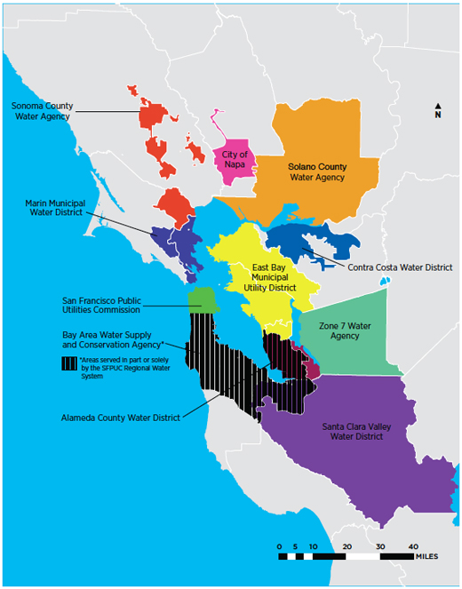
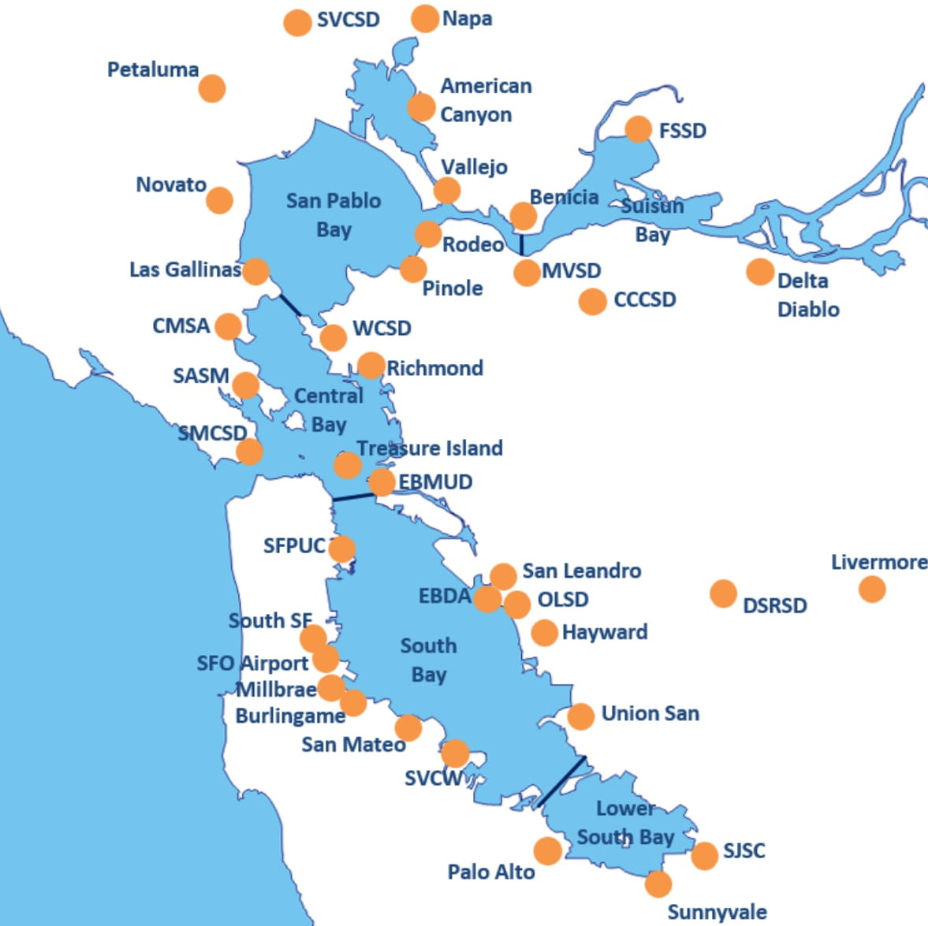

Slide 5
Lessons from Successful Reuse Programs
Governance
Problems evolve faster than institutions.
Regulations
Unclear regulations discourage agencies from sharing responsibility.
Economics
Collaborating agencies must agree on how to account for benefits, share costs and revenues
Management
Responsibility for operation of the reuse system and liability for performance don’t always follow jurisdictional boundaries.
Leadership
Leaders must invest personal time to engage members of their own agency and build relationships with external partners.

Slide 6
Our Approach
Draw on National Work on Multi-Agency Water Reuse Collaboration
EPA sponsored WRAP 2.16 report (2022)
Water Research Foundation Project WRF#5250 (Ongoing)
Review Key Planning Documents
Individual agency Urban Water Management Plans
Integrated Regional Water Management Plans
Bay Area Regional Reliability Plan
Local Climate Resilience Plans
Interview Alameda County Water/Wastewater Agencies, Related Entities
ACWD | CVSD | DSRSD | EBDA | EBMUD
Hayward | Livermore | Ora Loma SD | USD | Zone 7
Central San | SFPUC | RWQCB | Stormwater managers

Slide 7
Water and Wastewater Agency Priorities
Water Supply Agency Concerns
Maintaining a reliable supply of high-quality water at all time
Disasters (Cybersecurity, earthquakes)
Drought (storage, banking, reuse)
Replacing aging infrastructure
Treating PFAS, emerging contaminants
Keeping rates affordable
Wastewater Agency Concerns
Meeting new Regional Board nutrient permit requirements
Infiltration/Inflow impacts on wastewater treatment plants
Treatment of PFAS, emerging contaminants
Replacing aging infrastructure
Adapting to climate change and sea-level rise
Keeping rates affordable

Slide 8
San Francisco Bay Nutrients Watershed Permit Order R2-2024-0013 (NPDES Permit CA0038873)
This Order requires the Dischargers to reduce dry season total inorganic nitrogen loads to San Francisco Bay by 40 percent regionwide compared to 2022 loads over a 10-year period, which is the maximum time allowed in an NPDES permit by the State Water Resources Control Board’s (State Water Board) Policy for Compliance Schedules in National Pollutant Discharge Elimination System Permits Compliance Schedule Policy; Resolution 2008-0025 ).

Slide 9
Reuse Challenges
Interest in Reuse Varies Widely
Water agencies favor adoption of cheaper supply alternatives
Wastewater agencies focusing on faster implementation of treatment technologies to remove nitrogen
Interagency cooperation among suppliers facilitates water transfers
Greater interest in reuse among agencies in eastern Alameda County
Shared Concerns about Water Reuse
Concerns about perceived high cost of reuse, residual pollutants in wastewater, and lack of public acceptance of potable reuse
No mechanisms for collaboration among “stovepipes” (water supply, wastewater, stormwater agencies)
Hard to get water supply agency attention on reuse BUT high potential for sub-regional collaborations

Slide 10
What could a resilience-focused Committee accomplish?
Share practices for collaboration on how the region can recycle water, or better utilize water that is already imported, so it is not only used once and discarded into the Bay.
Share best practices for water reuse and enhanced water utilization
Promote sustainable practices and address challenges related to water supply, wastewater discharge, and climate resilience.

Slide 11
What could a resilience-focused Committee accomplish?
Share practices for collaboration on how the region can recycle water, or better utilize water that is already imported, so it is not only used once and discarded into the Bay.
Share best practices for water reuse and enhanced water utilization
Promote sustainable practices and address challenges related to water supply, wastewater discharge, and climate resilience.
Pool information and analysis on risk management and resilience challenges; address mutual operational challenges (finance, workforce, supply chains)
Discuss mutually beneficial solutions to climate change and regulatory uncertainty
Create shared understanding of reuse costs and benefits and build public support for potable reuse with consistent messages

Slide 12
Project timeline (progress to date)
Tasks
Date Completed
Execute contract
Scoping meeting w/key agencies
Interview ten Alameda County water and wastewater agency managers and staff, Regional Water Board, others
Interview SFPUC, Central San managers and staff
January 2024
February 2024
July-November 2024
November 2024

Slide 13
Project timeline (next steps)
Tasks
Date Proposed
Summarize interview findings and circulate to interviewees for review and comment
Convene county-wide meeting to discuss findings with Alameda County water and wastewater agency managers and staff and develop recommendation for Committee
Submit report to LAFCO
January-February 2025
March-May 2025
June 2025

Slide 14
Questions?
Contact: Eric Rosenblum, P.E. (eric@envirospectives.com)

